Slide 1
Paysal

Slide 2
Abstract
Paysal is a payroll management system that is used to manage all your employee's financial records in a simple fashion. This payroll management system manages employee's salaries, deductions, other conveyance, net pay, bonuses and generation of pay-slips, etc.
Paysal eases managing of vast amounts of data by making the employee or faculty management & payroll processing easier.

Slide 3
Modules
Allowances and deductions
Employee Information management
Departments and Position management

Slide 4
User table
Sl.No | Feild | Data_type | Description
1 | u_id | varchar(10) | Primary key of the user
2 | username | Varchar(50) | UserName of the user
3 | fullname | Varchar(50) | Name of the user
4 | email | Varchar(25) | Email of the user
5 | phone | Int(10) | Phone of the user
6 | password | Varchar(50) | Password of the user
7 | type | Int(1) | Determine type of user

Slide 5
Department table
SI.No | Feild | Data_type | Description
1. | dept_id | Varchar(10) | Primary key
2. | department | Varchar(20) | Name of the department
Position table
SI.No | Feild | Data_type | Description
1. | dept_id | Varchar(10) | Primary key
2. | department | Varchar(20) | Name of the department

Slide 6
Employee table
Sl.No | Feild | Data_type | Description
1. | employee_id | Varchar(10) | Primary key
2. | ename | Varchar(20) | Name of the employee
3. | dept_id | Varchar(10) | Foreign key
4. | pos_id | Varchar(10) | Foreign key
5. | salary | Double | Basic salary
Position table
SI.No | Feild | Data_type | Description
1. | pos_id | Varchar(10) | Primary key
2. | position | Varchar(25) | Position designation
3 | dept_id | Varchar(10) | Foreign key

Slide 7
Allowances table
SI.No | Feild | Data_type | Description
1. | allo_id | Varchar(10) | Primary key
2. | name | Varchar(10) | Allowance name
3. | amount | Int(10) | Allowance amount
Deduction table
SI.No | Feild | Data_type | Description
1. | allo_id | Varchar(10) | Primary key
2. | name | Varchar(10) | Allowance name
3. | amount | Int(10) | Allowance amount

Slide 8
UML DIAGRAMS

Slide 9
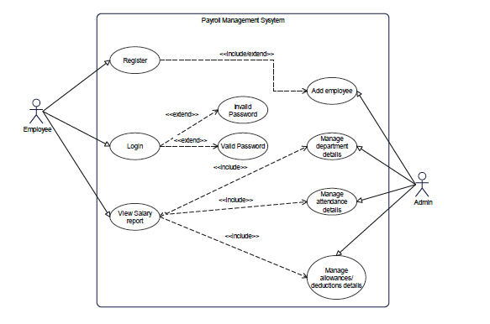
Use case Diagram

Slide 10
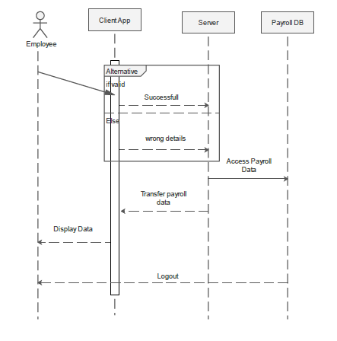
Sequence Diagram

Slide 11
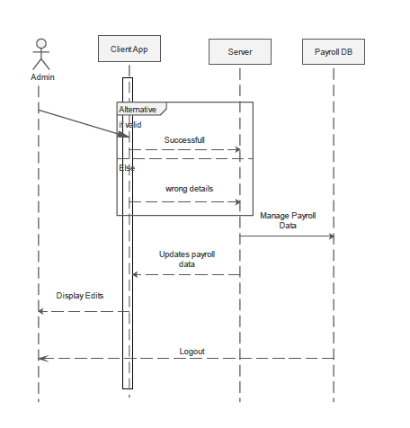

Slide 12
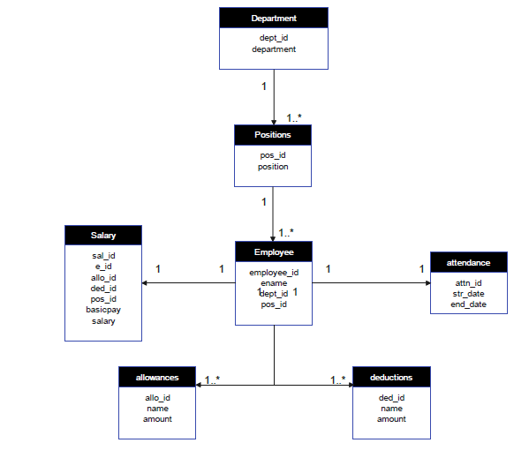
Object Diagram

Slide 13
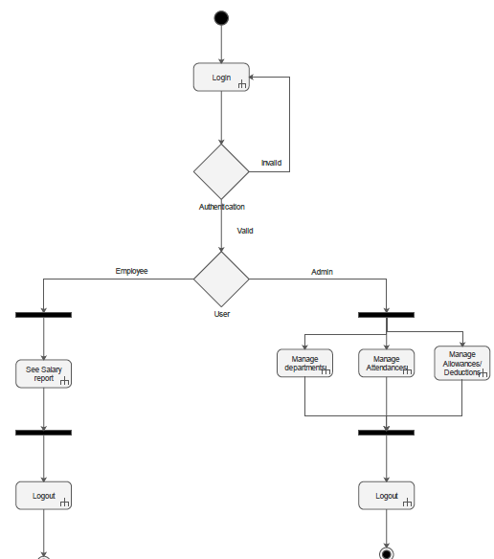
Activity Diagram

Slide 14
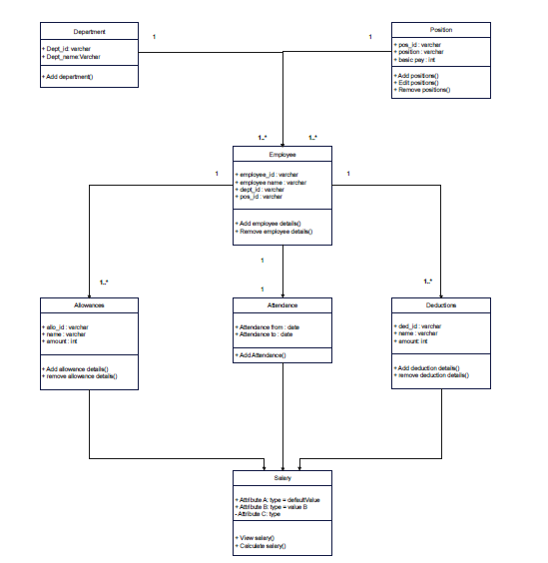
Class Diagram

Slide 15
Conclusion

Slide 16
PaySal is a web application developed for a company has been designed to achieve maximum efficiency and reduce the time taken to handle the Payroll activity. It is designed to replace an existing manual record system thereby reducing time taken for calculations and for storing data. The system uses HTML, css, javascript as front end and PHP as a backend for the database. The system is strong enough to withstand regressive daily operations under conditions where the database is maintained and cleared over a certain time of span. The implementation of the system in the organization will considerably reduce data entry, time and also provide readily calculated reports.

Slide 17
Thank You!

